Slide 1
Lecture 4: Probability & Information Theory
BINF 4002

Slide 2


Slide 4
Gemini?
Generated 11 slides.
This deck (less these LLM slides) has 52.

Slide 5
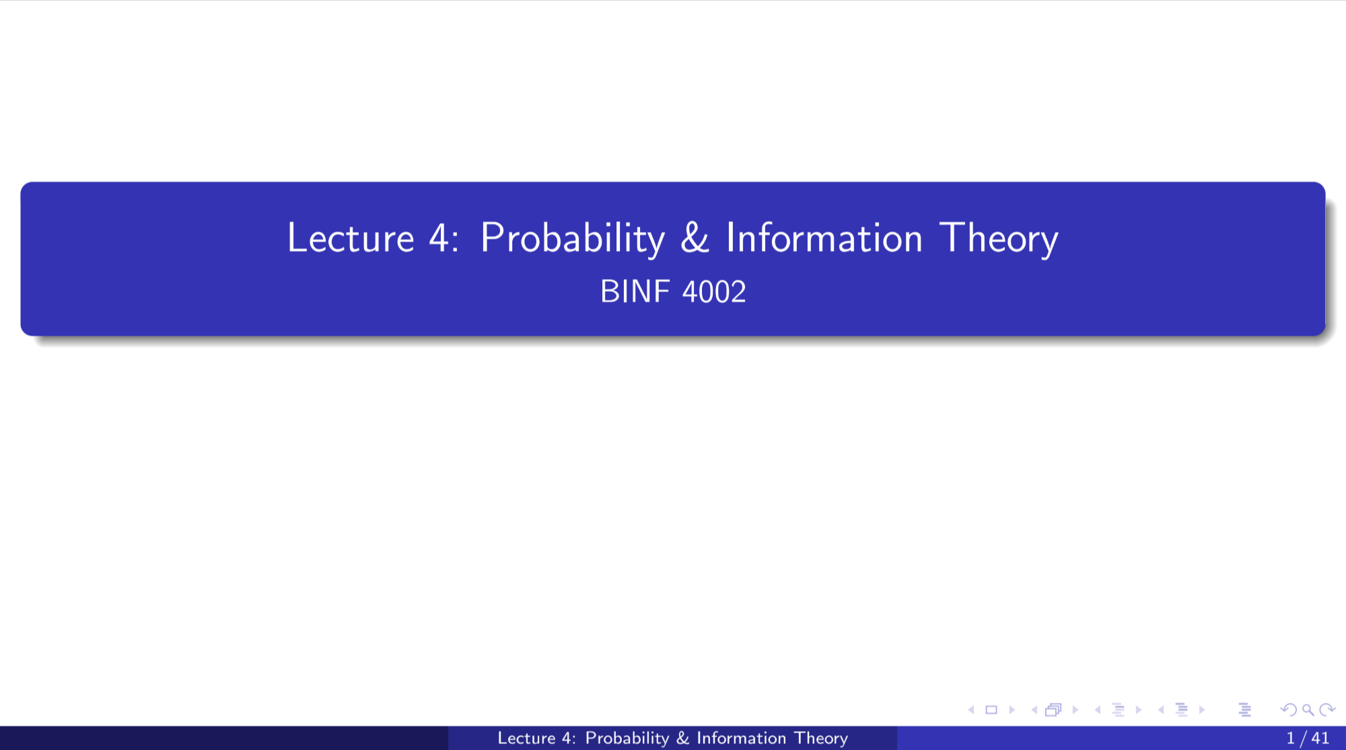
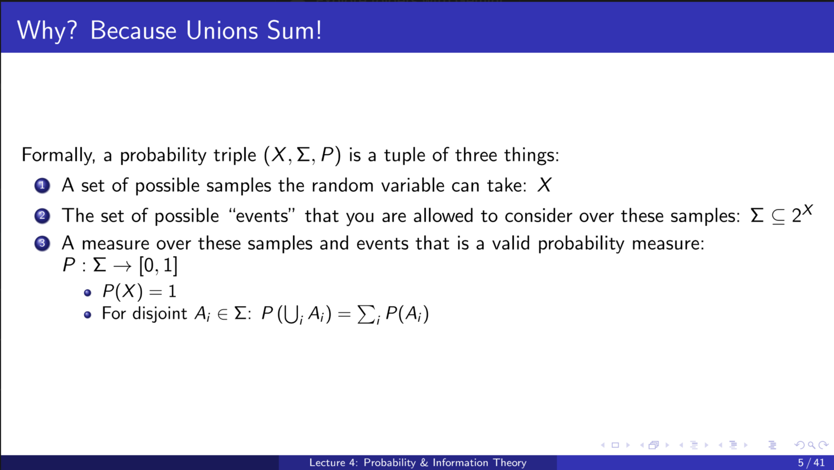
Claude
Oh my goodness it actually did it.

Slide 6
Vote:
Do you want to see Matthew’s slides, or Claude’s slides???

Slide 7
Outline
A quick note about expectation
Joint random variables, continued (Bayes rule, law of total probability)
Bayesian Statistics
Information Theory and Geometry
Statistics

Slide 8
Expectation and the law of large numbers
Expectation is useful in statistics because the probability that an average of observed independent samples will converge to the true expected value approaches 1.

Slide 9
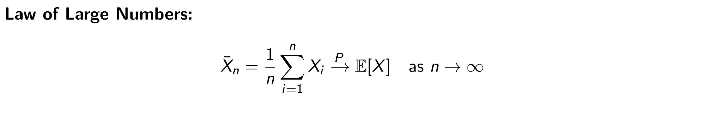
Expectation and the law of large numbers
Expectation is useful in statistics because the probability that an average of observed independent samples will converge to the true expected value approaches 1.

Slide 10
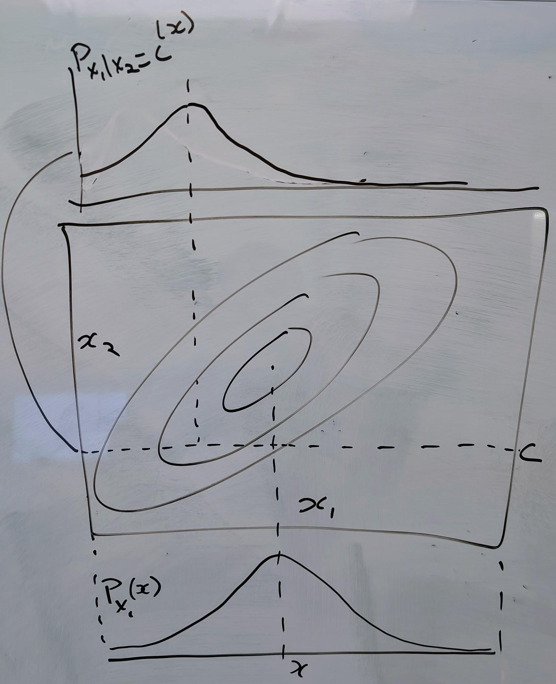

Slide 11
Given a joint distribution, what is a marginal?
Joint, 𝑃(𝑌, 𝑋)
Marginal 𝑃(𝑋) = ?

Slide 12
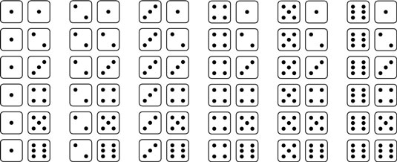

Slide 14
Why? Because unions sum!
Formally, a probability triple (𝑋, 𝛴, 𝑃) is a tuple of three things:
A set of possible samples the random variable can take: 𝑋
The set of possible “events” that you are allowed to consider over these samples: 𝛴 ⊆ 2^{𝑋}
A measure over these samples and events that is a valid probability measure: 𝑃: 𝛴 → [0, 1].
𝑃(𝑋) = 1
For disjoint 𝐴_{𝑖}∈𝛴, 𝑃(⋃_{𝑖} 𝐴_{𝑖}) = ∑_{𝑖} 𝑃(𝐴_{𝑖})

Slide 15
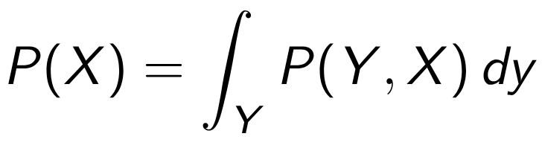
Marginal is the integral over the joint!
Joint, 𝑃(𝑌, 𝑋)
Marginal:

Slide 16
And the conditional?
Joint, 𝑃(𝑌, 𝑋)
Marginal
Conditional 𝑃(𝑌 | 𝑋) = ?

Slide 19
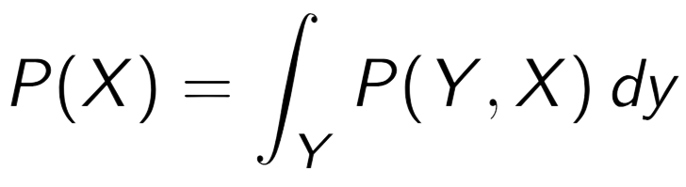
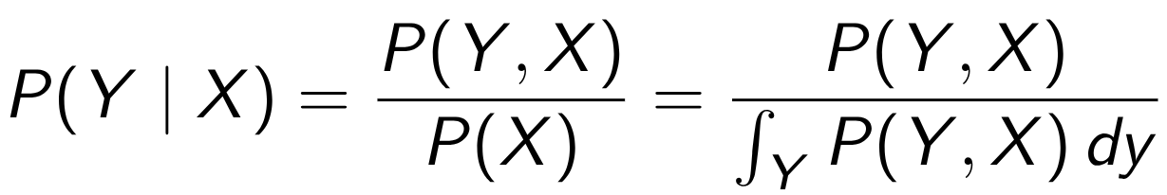
Conditional is the joint, renormalized
Joint, 𝑃(𝑌, 𝑋)
Marginal
Conditional

Slide 20
Conditional is the joint, renormalized
Joint, 𝑃(𝑌, 𝑋)
Marginal
Conditional

Slide 21
What about independent vs. dependent random variables?
If x, y independent, then 𝑃(𝑌, 𝑋) = 𝑃(𝑋)𝑃(𝑌), and 𝑃(𝑋 | 𝑌) = 𝑃(𝑋)

Slide 22
Bayes rule:
𝑃(𝑌 | 𝑋) 𝑃(𝑋) = 𝑃(𝑋 | 𝑌) 𝑃(𝑌)

Slide 23
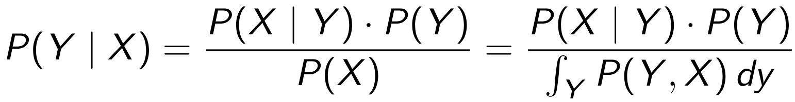
Bayes rule:
𝑃(𝑌 | 𝑋) 𝑃(𝑋) = 𝑃(𝑋 | 𝑌) 𝑃(𝑌)
Equivalently...

Slide 24
Bayesian Statistics
𝑃(𝑌 | 𝑋) = 𝑃(𝑋 | 𝑌) 𝑃(𝑌) / 𝑃(𝑋)
𝑃(𝑌 | 𝑋) = 𝑃(𝑌) (𝑃(𝑋 | 𝑌) / 𝑃(𝑋))
Posterior = Prior * (likelihood / evidence)

Slide 25
Key Points about Bayesian Inference!

Slide 26
A prior is not your “belief” or “guess”. It is the marginal for the joint random variable.

Slide 27
A prior is not your “belief” or “guess”. It is the marginal for the joint random variable.

Slide 28
Bayesian Inference is only valid if your prior is valid...
But if you use the right prior, it may be useful regardless

Slide 29
Bayesian Inference is only valid if your prior is valid...
But if you use the right prior, it may be useful regardless

Slide 30
All models are wrong but some are useful.
George E. P. Box

Slide 31
Example of a bad prior

Slide 32
Also study
Law of total probability
Law of total expectation
Law of total variance

Slide 33
Information Theory

Slide 34
Information axioms (Shannon)
An event with probability 100% is perfectly unsurprising and yields no information.
The less probable an event is, the more surprising it is and the more information it yields.
If two independent events are measured separately, the total amount of information is the sum of the self-informations of the individual events.

Slide 35
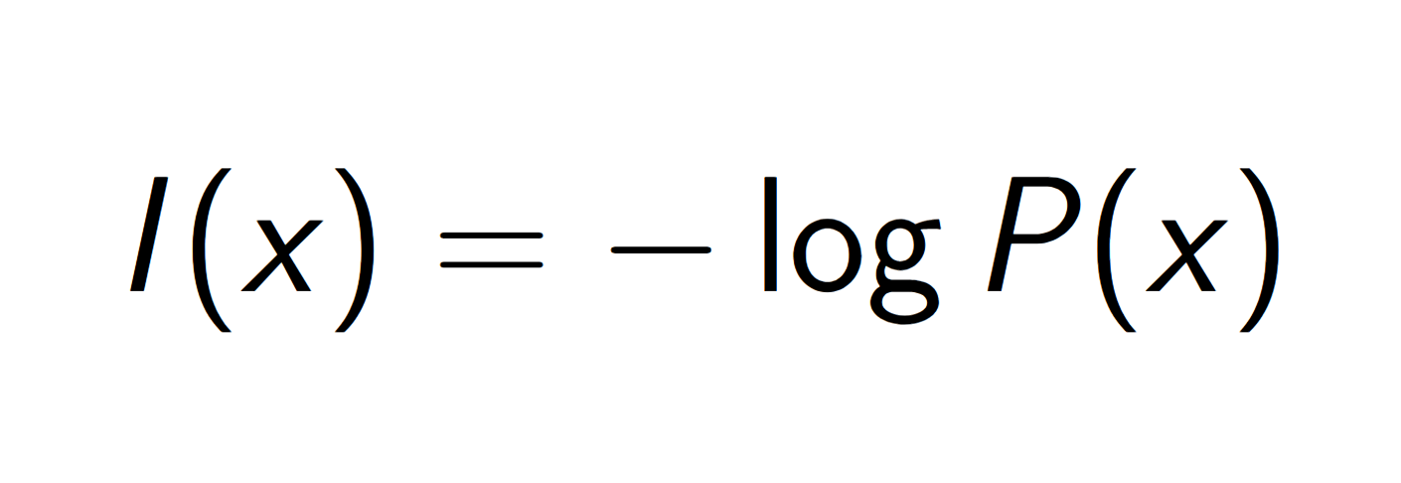
The Unique Information Content Function
I(x) = -log(P(x))

Slide 36
Does this really quantify “information”?

Slide 37
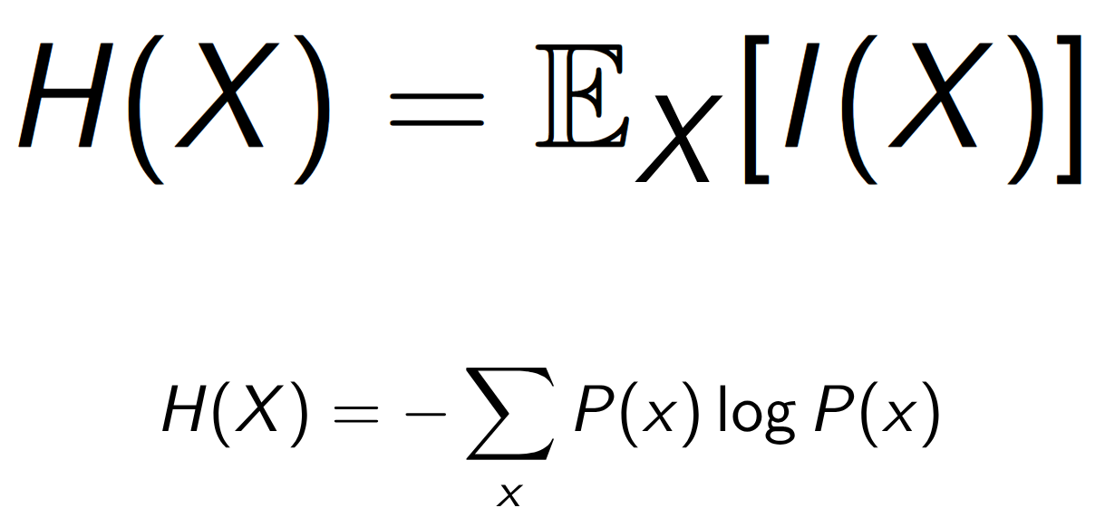
Entropy: Expected information content!
Notes:
https://chatgpt.com/share/697aab84-f514-800c-9189-8f5a3d0f1542

Slide 38
Entropy: Expected information content!
Notes:
https://chatgpt.com/share/697aab84-f514-800c-9189-8f5a3d0f1542

Slide 39
Entropy is disorder/uncertainty... but it's the average information content?

Slide 40
Coding Theorem:
The average number of bits needed to encode a stream of iid random variables drawn from X is the average information content of X -- a.k.a. H(X)

Slide 41
Coding theorem proof argument (in 1 sentence)
Basically every sequence that you’d actually ever see of n iid random variables from X lives in a set no bigger than 2^{n H(x)} -- regardless of the values X can take on!

Slide 42
Coding theorem proof (in more sentences)
By the law of large numbers, the average observed total information content of a sampled sequence will converge to the expectation of the information content of the distribution (a.k.a., the entropy).
This means that almost all observed sequences will have probability not far from 2^{-n H(x)}.
How many sequences make up this set of “almost all observed sequences”? It can’t be more than (roughly) 1/2^{-n H(x)}
Because otherwise the total probability of all those sequences together would be more than 1!
So, almost all observed sequences will come from a set of size no bigger than roughly 2^{n H(x)}

Slide 43
Information content quantifies “information” because the law of large numbers and properties of logs mean we can translate between log probabilities and the log of the number of possible observed options across iid samples.

Slide 44
Information axioms (Shannon)
An event with probability 100% is perfectly unsurprising and yields no information.
The less probable an event is, the more surprising it is and the more information it yields.
If two independent events are measured separately, the total amount of information is the sum of the self-informations of the individual events.

Slide 45
What about independent vs. dependent random variables?
If x, y independent, then P(X, Y) = P(X) * P(Y), and P(X|Y)=P(X)

Slide 46
What about independent vs. dependent random variables?
If x, y independent, then P(X, Y) = P(X) * P(Y), and P(X|Y)=P(X)
log(P(X) * P(Y)) = log(P(X)) + log(P(Y))

Slide 47
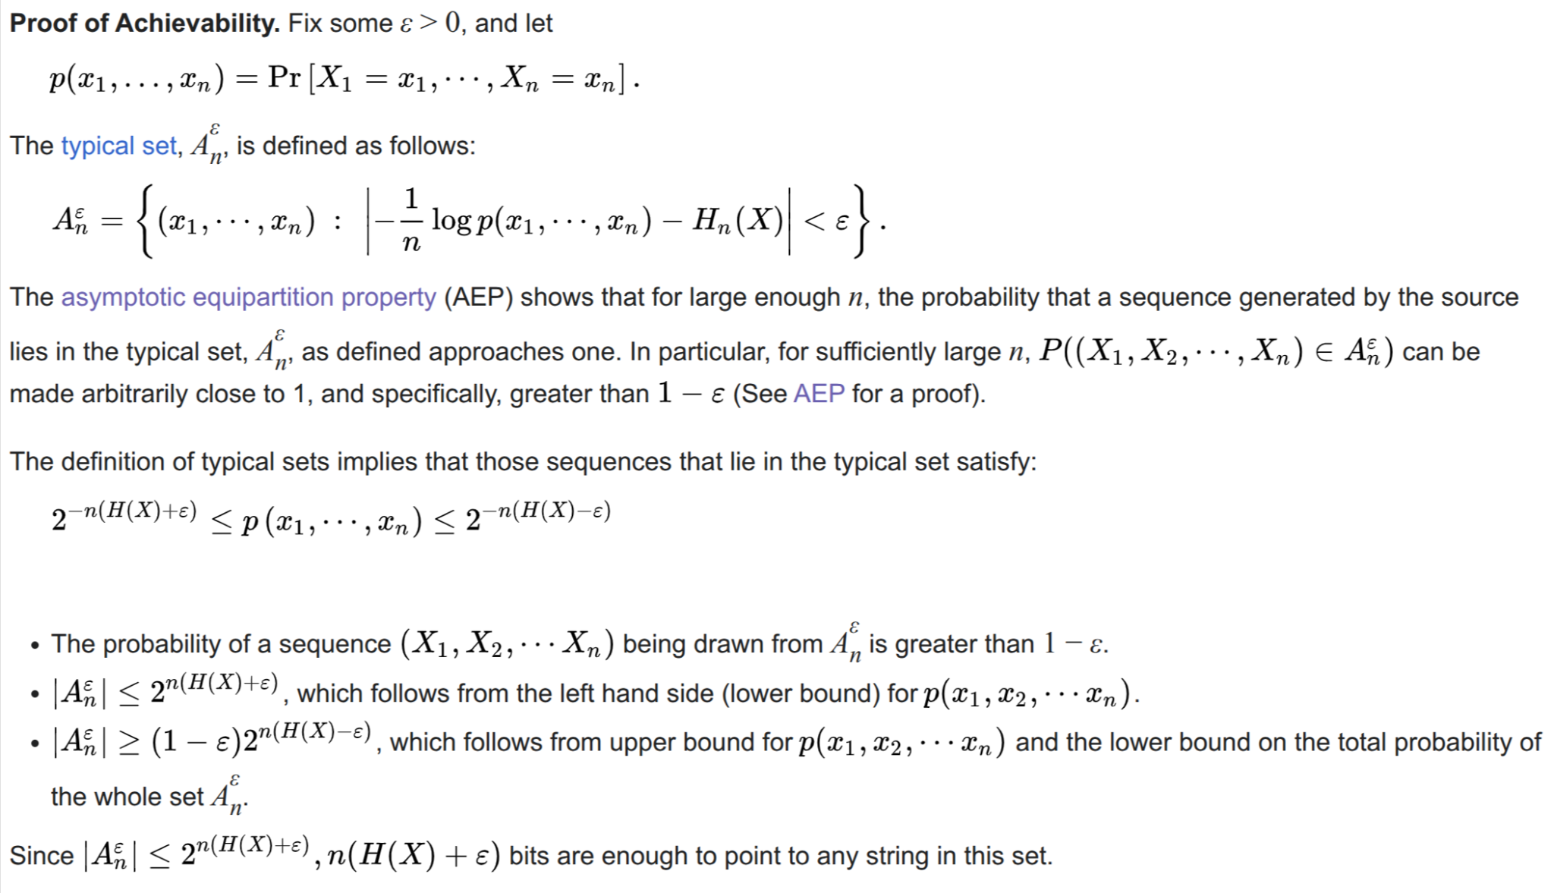
Coding theorem proof (in more sentences)

Slide 48
What if I encode samples from a distribution P with a model from distribution Q?

Slide 49
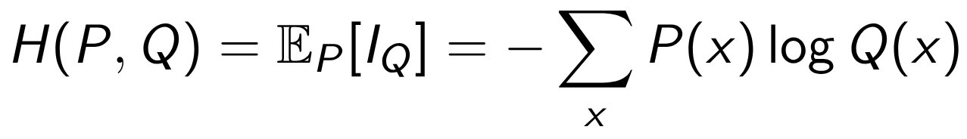
Cross Entropy

Slide 50
Caveat: What’s information for continuous distributions? What’s entropy?
Notes:
https://chatgpt.com/share/697aab84-f514-800c-9189-8f5a3d0f1542

Slide 51
Continuous Information and Entropy
For a continuous random variable, 𝑃({𝑥})= 0.
So, information content is infinite?
... What if we use (𝑑𝑃(𝑥)/𝑑𝑥)!
𝐻(𝑥) = ∫_{𝑋} -log(𝑝_{𝗑}(𝑥)) 𝑑𝑥!
... but what about units?
We said: “Suppose that each atom of 𝑋 has size 𝑑𝑥. Then I can write: ∫_{𝑆} (𝑑𝑃(𝑥)/𝑑𝑥) 𝑑𝑥 = 𝑃(S)”
This means has units of “change in probability” divided by “size of X”. What is the “log” of these units?

Slide 52
This is not a philosophical problem!
Suppose I have a uniform distribution from a to b
The differential entropy of this distribution is log(b-a).
What happens if I scale the real numbers, so a to b becomes c*a to c*b.
Differential entropy changes!
This means I am more uncertain about the distribution of our heights in millimeters than I am about it in centimeters than I am about it in inches ...

Slide 53
... but then again maybe it is?
I need more digits to capture the same quantity in mm than I do in cm than I do in inches than I do in feet

Slide 54
Solution! Relative Entropy Differences

Slide 55
Mutual Information
I(X;Y) = H(X) - H(X | Y) = H(Y) - H(Y | X)
Exists and is the same natural thing for both discrete and continuous RV
I(X; Y) = 0 if and only if X and Y are independent.

Slide 56
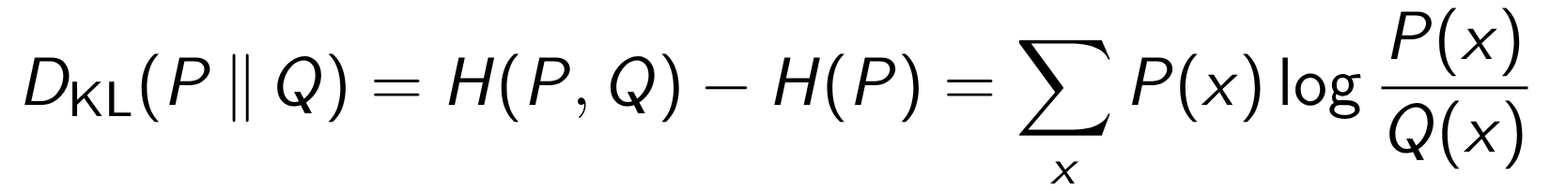
KL-divergence

Slide 57

KL-divergence
Number of extra bits needed to encode via the wrong distribution q vs. the right distribution p.
Pseudo distance metric for probability spaces.
NOT symmetric:

Slide 58
Also study...
Fisher information (Entropy captures bits per data sample, what about bits per parameter changes?)
Optimal transport / Earth-mover’s distance
Maximum likelihood estimation vs. maximum a posteriori
Challenges with re-normalization

Slide 59
Statistics:
If you can actually randomly sample, you can learn a lot from a small amount of data. If you can’t, you’re toast.

Slide 60
Statistics:
If you can actually randomly (iid) sample, you can learn a lot from a small amount of data. If you can’t, you’re toast.

Slide 61
Statistics:
If you can actually randomly (iid) sample, you can learn a lot from a small amount of data. If you can’t, you’re toast.

Slide 62
Also study
How to estimate properties of a distribution in an unbiased manner (why is the denominator in the sample variance n-1?).
Hypothesis Testing (False discovery rate correction, permutation tests, Lindley’s Paradox).
Correlation tests of different varieties.
Efficient monte carlo sampling strategies in high dimensions.

